Slide 1

SAFETY IMPROVEMENTS FOR SR 112/ARTHUR GODFREY ROAD
From Alton Road to West of Pine Tree Drive
Prepare By: Relative Point Engineering Inc.
March 3th, 2017

Slide 2

About The Customer
The Florida Department of Transportation (FDOT or Department) is an executive agency, which means it reports directly to the Governor.
FDOT’s primary responsibility is to coordinate the planning and development of a safe, viable, and balanced state transportation system serving all regions of the state

Slide 3
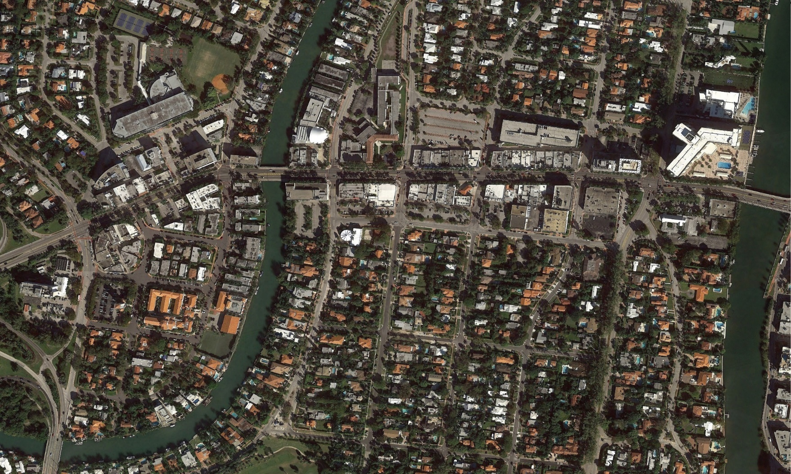
Introduction
SR-112 is a two-lane two-way roadway with a left-turn lane.
Highly transited roadway with approximately 41,000 ADT.
In a 3-year period from 2011 to 2014, this roadway experienced a high number of crashes.
N
Jefferson Ave
Meridian Ave
Chase Ave
Prairie Ave
Sheridan Ave
Pine Tree Dr
Royal Palm Ave
Alton Road
Garden Ave
SR 112/Arthur Godfrey Rd from Alton Rd to Pine Tree Dr

Slide 4
Problem Statement
A total of 307 crashes for 3-years period from 2011 to 2014 for the project segment
Alton Rd segment - 36 crashes
Garden Avenue segment - 19 crashes
Jefferson Avenue segment - 19 crashes
Meridian Avenue segment - 25 crashes
Chase Avenue segment – 38 crashes
Prairie Avenue segment– 44 crashes
Royal Palm Avenue segment – 61 crashes
Sheridan Avenue segment – 65 crashes

Slide 5

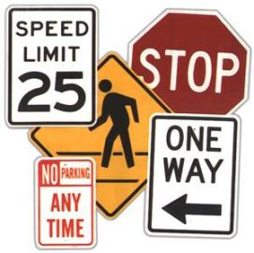
Scope
Safety project to reduce all types of crashes.
Safety study to determine the causes of the crashes and propose the required improvements to mitigate the crashes.
Design of the recommended Roadway improvements.
Design of the recommended Signalization improvements.
Design of the recommended Signing and Pavement Markings improvements.

Slide 6
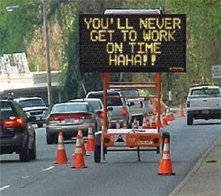
Project Significance
Safety Improvements could result in a crash reduction of approximately 60% of the crashes per year.
Pedestrian ways improvement will benefit this area of Miami Beach, which is heavy in pedestrian and bicycle traffic.
Additional benefits will be reflected in the reduction of rush hour traffic due to the signalization improvements.

Slide 7
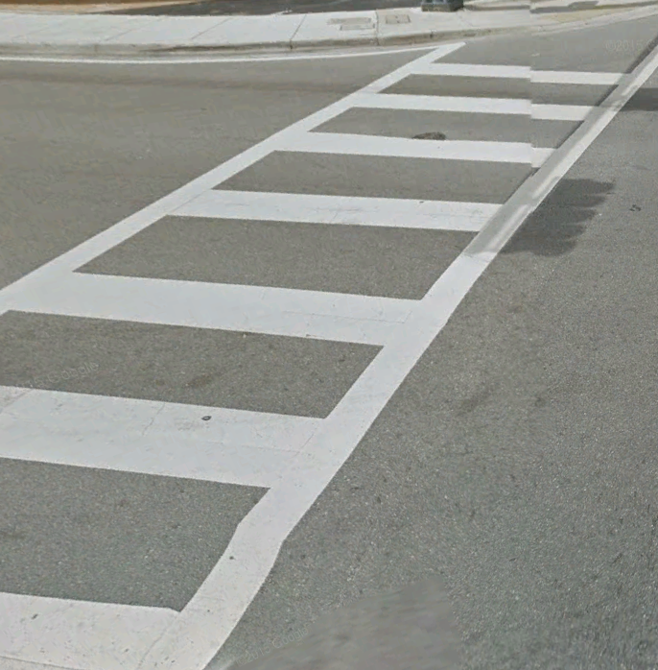
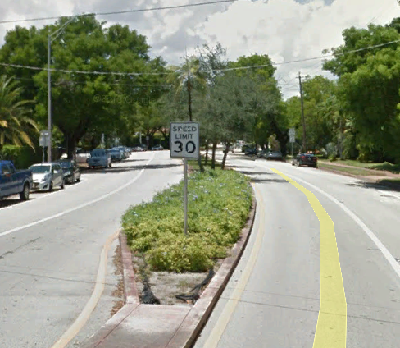
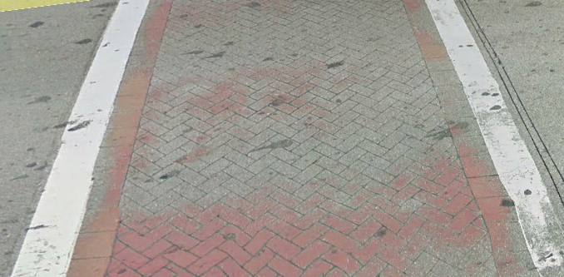
Proposed Approach
New raised landscaped median for uncontrolled pedestrian crossings.
High emphasis crosswalk for driver awareness due to large volume of pedestrians (including schools).
Signalization and Signing & Pavement Markings improvements (for safety).
Proposed High Emphasis
Raised Landscaped Median to discourage uncontrolled pedestrian crossings
Existing
Crosswalk

Slide 8
Proposed Approach
1.0 Safety Improvements for State Road 112
2.1 Safety Study Phase
3.1 Design Phase
4.1 Construction Phase
2.1.1 Existing Conditions Evaluation
2.1.2 Proposed Improvements
2.1.3 Benefit-Cost Analysis
3.1.1 Design Plans
3.1.2 Cost Estimate
3.1.3 Specifications
4.1.1 Construction Schedule
4.1.2 Procurement
4.1.3 Construction

Slide 9
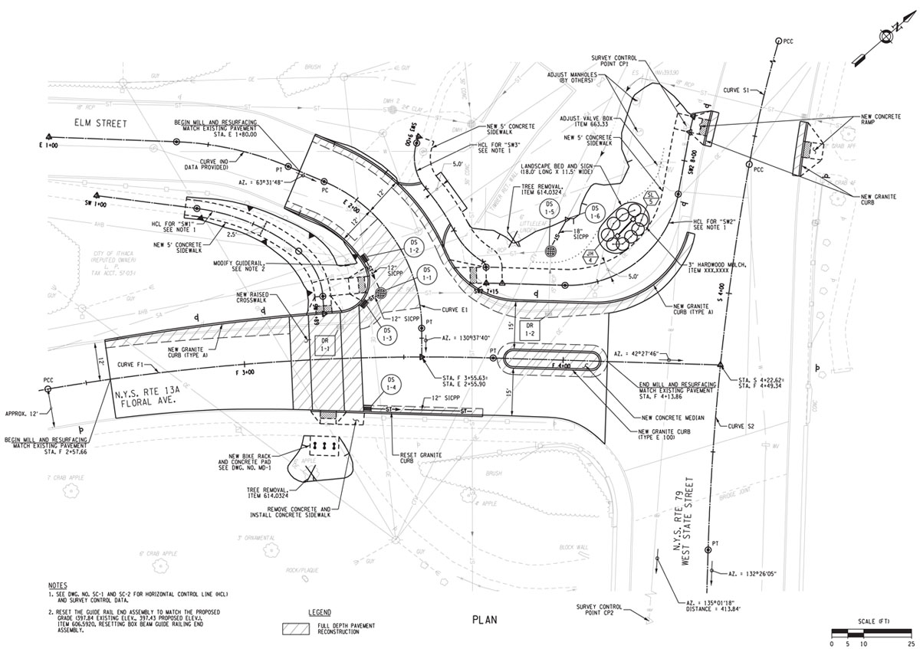
Contractual Aspects
Deliverables:
Safety Study Report
Design Plans
Cost Estimate
Specifications
Construction Schedule

Slide 10
Preliminary Resources
 | Manpower
2.1 Safety Study Phase
2.1.1 Exist. Conditions Evaluation | 120 hrs
2.1.2 Proposed Improvements | 180 hrs
2.1.3 Benefit-Cost Analysis | 125 hrs
3.1 Design Phase
3.1.1 Plans | 240 hrs
3.1.2 Cost Estimate | 180 hrs
3.1.3 Specifications | 210 hrs
4.1 Construction Phase
4.1.1 Pre-construction | 350 hrs
4.1.2 Procurement | 280 hrs
4.1.3 Construction | 650 hrs

Slide 11
Preliminary Costs
 | Manpower | Unit Cost | Cost
2.1 Safety Study Phase
2.1.1 Exist. Conditions Evaluation | 120 hrs | $120.00 | $14,400.00
2.1.2 Proposed Improvements | 180 hrs | $120.00 | $21,600.00
2.1.3 Benefit-Cost Analysis | 125 hrs | $120.00 | $15,000.00
3.1 Design Phase
3.1.1 Plans | 1240 hrs | $120.00 | $148,800.00
3.1.2 Cost Estimate | 380 hrs | $120.00 | $45,600.00
3.1.3 Specifications | 210 hrs | $120.00 | $25,200.00
4.1 Construction Phase
4.1.1 Pre-construction | 250 hrs | $150.00 | $37,500.00
4.1.2 Procurement | 280 hrs | $150.00 | $42,000.00
4.1.3 Construction | 10650 hrs | $150.00 | $1,597,500.00
Total Cost |  |  | $1,947,600.00

Slide 12

Questions?

